Slide 1
UAE YACHT
REGULATIONS
PRIVATE YACHTS

Slide 2
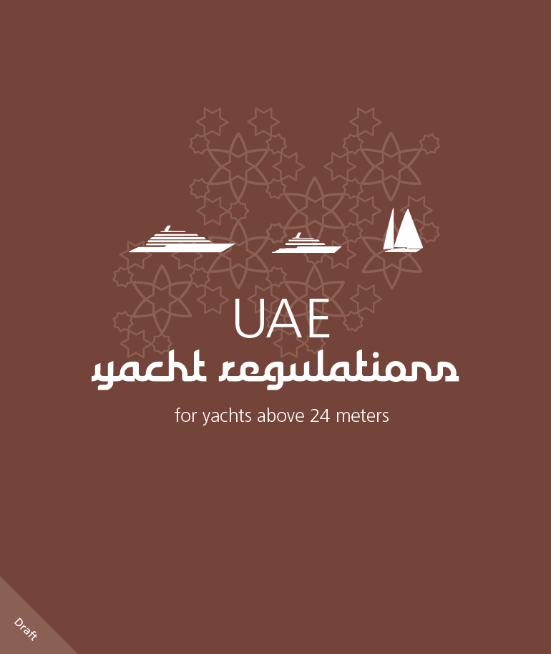
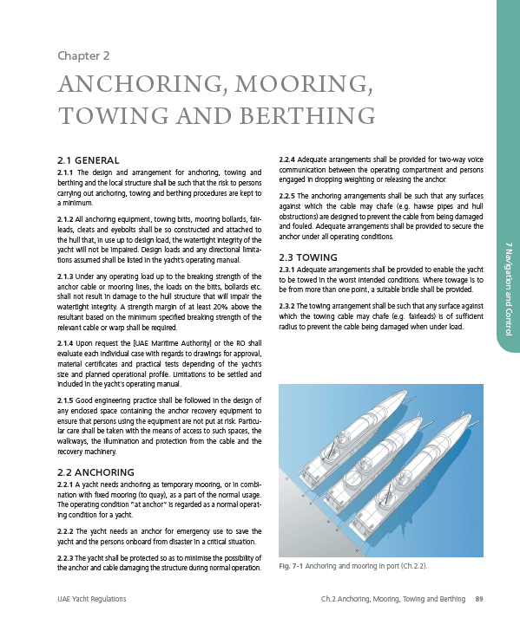
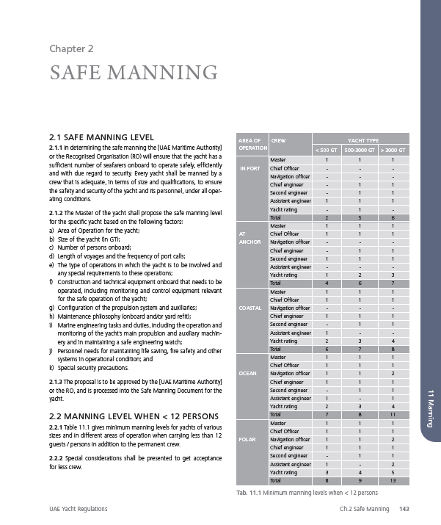
CONTENTS
Introduction
Applicability
Main Features
Key Issues
  Design and Construction
  Operational Aspects
Verification of Compliance
Surveys and Certification
TASNEEF Support
Benefits to Owners and Industry
What is next?
Conclusion

Slide 3
INTRODUCTION
The UAE Federal Transport Authority has identified a need for yacht regulations that address the larger size segment of the private yachts, i.e. yachts above 24 meters not intended for commercial use, without any restriction with respect to the number of persons onboard, nor to the maximum size of the yacht.
The international conventions and regulations applicable to conventional vessels are not applicable for yachts not engaged in commercial trade.
Most of the yachts in the lowest segment of size above 24 meters are built in series by established yacht manufacturers as per recognized international standards and are well tested before released to market.
Larger yachts are increasingly being custom built based on individual designs.
The current codes and regulations for the larger yachts are based on conventional steel ship technology which imposes strong limitations on the innovative and future orientated yacht industry.
The present statutory regime for certification of commercial yachts is not considered to be an appropriate long term solution for the non-commercial segment of the yacht industry which builds private yachts not intended for the leasing market.

Slide 4
APPLICABILITY
The UAE Yacht Regulations are applicable for private yachts 24 meters in length or above.
  New and existing yachts
  Any type of yacht (Motor Yacht, Sailing Yacht etc.)
  Any construction material (Steel, Aluminum, Composites etc.)
  Any hull shape (single / multi hull)
  Any type of propulsion

Slide 5
MAIN FEATURES
  No limitations : No size / tonnage limitation - No limits for maximum number of persons on board.
  Developed for private yachts.
  Prescriptive rules and risk assessment based solutions.
  Approval by a recognized Classification Society is required for all yachts ≥ 400 GT due to full compliance with mandatory international conventions (MARPOL).
  Verification (plan appraisal and surveys) carried out by either FTA or a delegated Recognized Organization
  The Code recalls IMO Conventions such as SOLAS, High Speed Craft Code, International Load Line

Slide 6
MAIN FEATURES
  Safety Requirements vary depending on the following governing parameters:
    Gross tonnage of the yacht (GT)
      GT < 400: the prescriptive requirements of the Code apply
      GT ≥ 400: international conventions such as MARPOL, SOLAS Cargo Ships, SOLAS Passenger Ships, HSC Code, SPS Code
    Number of guests
      N < 12
      12 ≤ N ≤ 60
      N > 60
    Areas of operation
      POLAR: operated in water with extreme weather conditions (including ice); no rescue assistance assumed available
      OCEAN: the yacht might be exposed to heavy sea states and outside the range of rescue assistance from shore
      COASTAL: areas in which the yacht can rapidly recover in a sheltered area and suitable rescue facilities readily available
    Modes of operation
      TRANSFER MODE: only crew on board
      NORMAL MODE: full capacity of crew and guests
      EVENT MODE: at anchor or at a distance of less than 5nm from safe refuge. Capacity of guests can be increased subject to a temporary increased number of crew and lifesaving on board

Slide 7
AREA OF OPERATIONS
Port
Coastal
Ocean
Polar

Slide 8
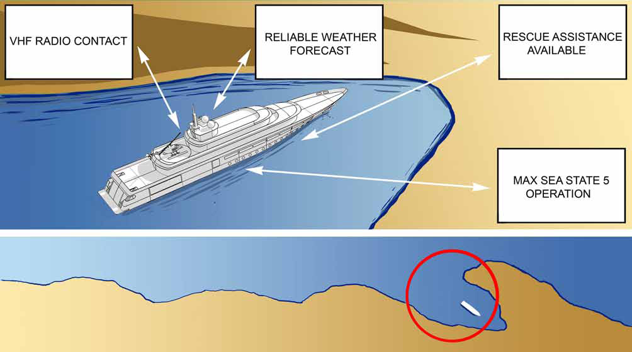
PRECONDITIONS FOR COASTAL OPERATION & PORT OF REFUGE CONCEPT

Slide 9
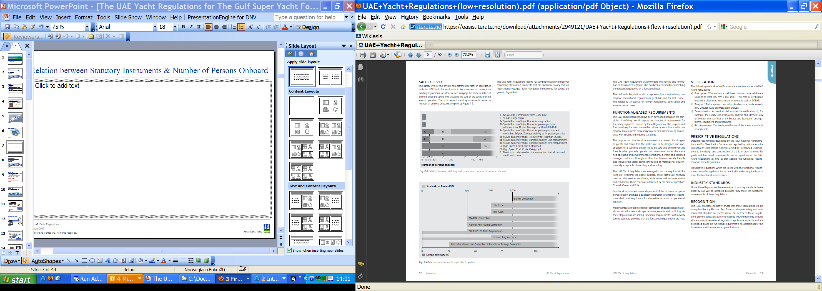
MAX. NUMBER OF PERSONS ONBOARD IN STATUTORY INSTRUMENTS

Slide 10

STATUTORY INSTRUMENTS APPLICABLE TO YACHTS

Slide 11

MAIN FEATURES – CONTENTS
Part 1 General Provisions
Part 2 Buoyancy and Stability
Part 3 Structural Integrity
Part 4 Machinery and Electrical Installations
Part 5 Pollution Prevention
Part 6 Accommodation Safety, Security and Comfort
Part 7 Navigation and Control
Part 8 Fire Safety
Part 9 Life Saving
Part 10 Equipment Carried On board
Part 11 Manning
Part 12 Surveys and Certification
Annexes Certificates

Slide 12
VERIFICATION OF COMPLIANCE
The following methods of verification are equivalent under the UAE Yacht Regulations:
Prescriptive: this type of verification method is often used in statutory instruments such as SOLAS and Classification Societies’ rules.
Analysis: this method involves studies and calculations according to standards and guidelines provided by or agreed with IMO, Flag/RO and/or Classification Societies.
Demonstration: a practical trial enables the verification of the issue in question.
Risk Assessment: can be chosen if none of the above is feasible or applicable.

Slide 13
MAIN GOVERNING PARAMETERS
The main governing parameters described below are used to differentiate on the measures needed to meet the functional requirements within the segments covered by the UAE Yacht Regulations:
Number of Guests:
< 12 / 12-60 / >60
Area of Operation:
Coastal / Ocean / Polar
Mode of Operation:
Transfer / Normal / Event
Type of yacht:
Sail / Motor / Expedition

Slide 14
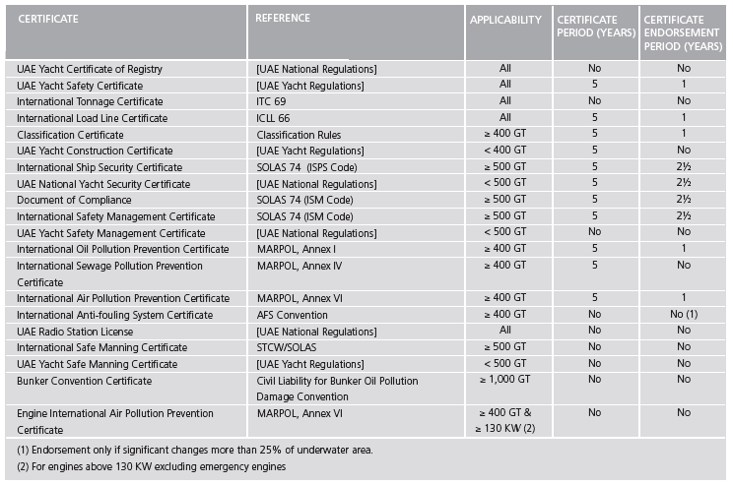
SURVEYS AND CERTIFICATION
LIST OF CERTIFICATES TO BE ISSUED

Slide 15
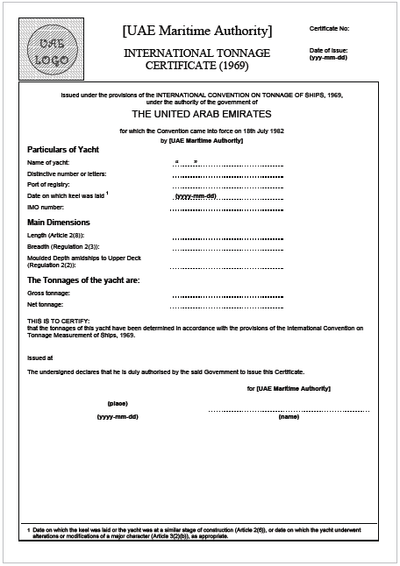
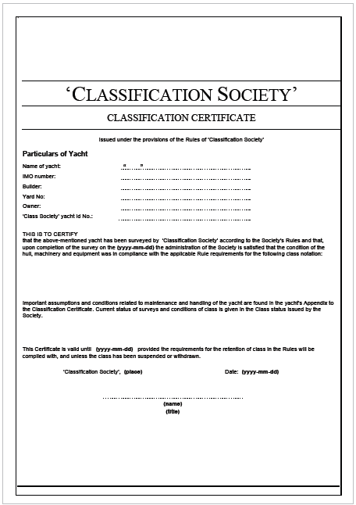
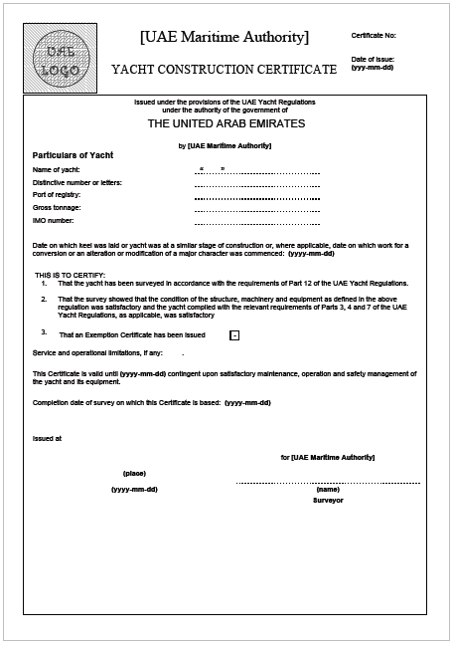
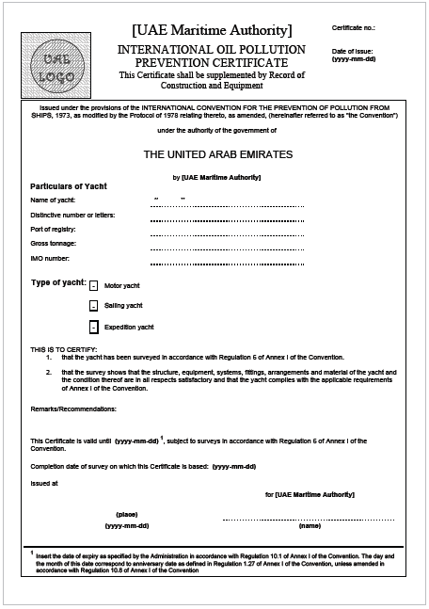
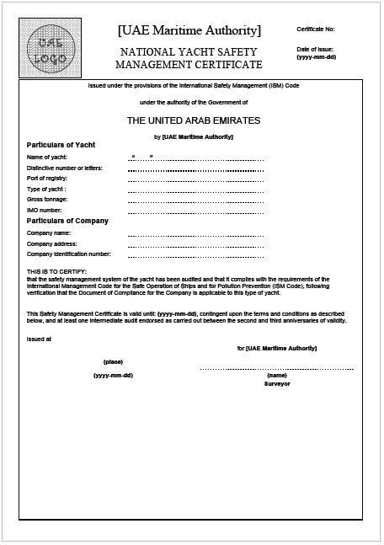
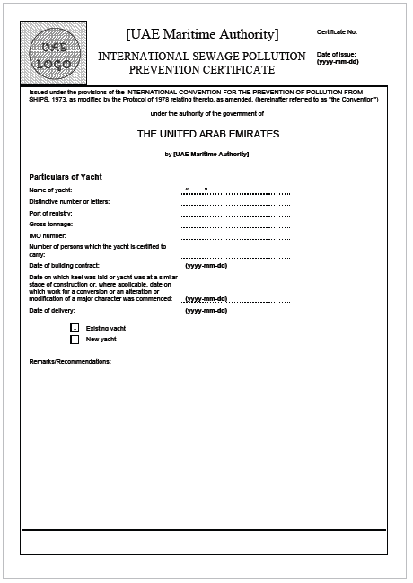
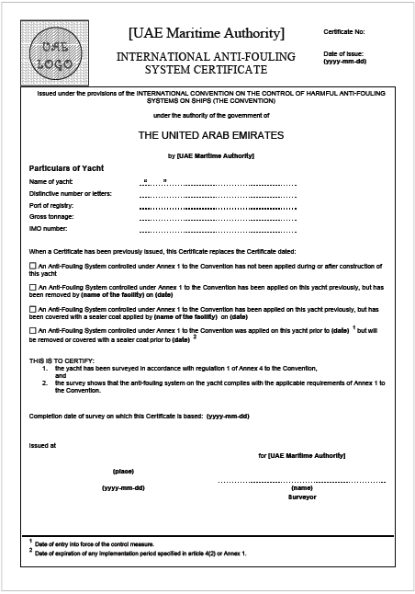
SURVEYS AND CERTIFICATION
Certificate Regime
Yacht Certificate of Registry
Loss of any applicable certificate in the lowest tier will mean loss of the Yacht Safety Certificate and the Yacht Certificate of Registry
Yacht Safety
Certificate
International Tonnage
Certificate
International Load Line
Certificate
Classification
Certificate
Yacht Construction Certificate
International / Yacht Security
Certificate
Document of Compliance
Safety Management
Certificate
MARPOL
Certificates

Slide 16
SURVEYS AND CERTIFICATION
SURVEYS
1. INITIAL SURVEY : Means the survey to verify that the yacht is in compliance with the requirements of applicable regulations in order to issue the relevant certificate for the first time for maximum 5 years validity.
The Initial Survey scope consists of:
a) an appraisal of the assumptions made and limitations proposed in relation to loadings, environment, speed and maneuverability;
b) an appraisal of the data supporting the safety of the design, obtained, as appropriate, from calculations, tests and trials;
c) an investigation into the adequacy of the various manuals to be supplied with the yacht;
d) a complete survey of the structure, safety equipment, radio installations and other equipment, fittings, arrangements and materials to ensure that they are in full compliance with the technical requirements in these Regulations, are in satisfactory condition and are fit for the operation for which the yacht is intended; and
e) verification that the yacht is built according to approved drawings.
2. RENEWAL SURVEY : The renewal survey shall include a complete inspection/survey of the structure, including the outside of the yacht’s bottom and related items, safety equipment, radio installations and other equipment to ensure that they comply with the requirements of the applicable regulations, are in satisfactory condition and are fit for the area of operation for which the yacht is intended. The survey of the yacht’s bottom shall be conducted with the yacht out of the water under suitable conditions for close-up examination of any damage or problem.
3. PERIODICAL SURVEY : The periodical survey (annual survey) is similar to renewal survey except that the survey of the yacht’s bottom is not required. The survey is not as extensive as the renewal survey as random selection of survey items is done.
4. INTERMEDIATE SURVEY / AUDIT : The intermediate audit is similar to renewal audit. Such an audit is required in connection with Safety Management and Security certificates.
5. OCCASIONAL SURVEY : An additional occasional survey, either general or partial according to the circumstances, shall
be made upon a damage and repairs or renewals are made or upon observing serious deficiencies in connection with periodical surveys or port state control.

Slide 17
TASNEEF SUPPORT……
TASNEEF is the only Recognized Organization to carry out surveys and certification as per the UAE Yacht Regulations on behalf of The UAE Federal Transport Authority.
TASNEEF is in regular cooperation with the yachting industry in order to improve the yachting standards and achieve international recognition of the UAE Yacht Code.

Slide 18
TASNEEF SUPPORT……
TASNEEF has carried out the interpretation and preparations for implementation of the Yacht Code.
TASNEEF will continue its efforts to improve the application of the yacht code through scheduled workshops with participation from the industry professionals and constant feedbacks.

Slide 19
TASNEEF SUPPORT……
TASNEEF is committed to assist the yacht builders, owners, yachting professionals and other related parties to obtain compliance with the Yacht Code and related international standards.
TASNEEF can offer a preliminary assessment to owners to identify any gaps in order to comply with the UAE Yacht Code.

Slide 20
TASNEEF SUPPORT……
TASNEEF works in close cooperation with the UAE Federal Transport Authority for developing the standards and regulations required for the other yacht segments. (e.g. private yachts below 24 meters in length and large commercial yachts)

Slide 21
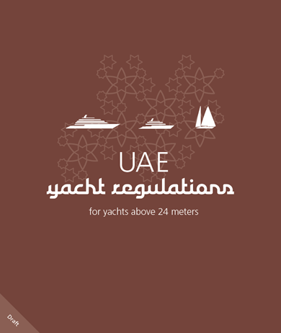
BENEFITS TO OWNERS AND INDUSTRY
UAE Yacht Code addresses the need of a statutory regulations
Clean Yacht Certificate allows the owner to sail internationally with No limitations:
  No size / tonnage limitation
  No max. number of persons on board
Safer yachting
  Compliance with international standards.
  Yachts will be surveyed and maintained to appropriate standards.
Attractive UAE flag (Quality based):
  Quality standards for Yachts
  Protecting the environment, life and assets
  Increased value to yachts flying UAE Flag.
Flexible and brings innovation (Functional requirements)

Slide 22
CONCLUSION
UAE Yacht Code addresses the need of a statutory regulation intended only for large private large yachts.
UAE Yacht Code brings innovative and comprehensive approach on design and operational aspects.
Flexible and innovative approach to the over 12 guests category, depending on areas and modes of operation.
Various benefits as discussed in previous slides to the owners, industry and environment.

