Slide 1

“THE SAFETY REGULATIONS FOR SHIPS THAT ARE NOT COVERED BY THE INTERNATIONAL CONVENTIONS”
THE CABINET RESOLUTION NO.(29) OF 2013
GCC CODE

Slide 2
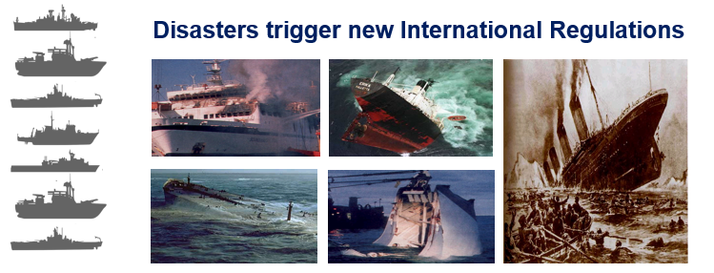
SHIP REGULATIONS HISTORY

Slide 3
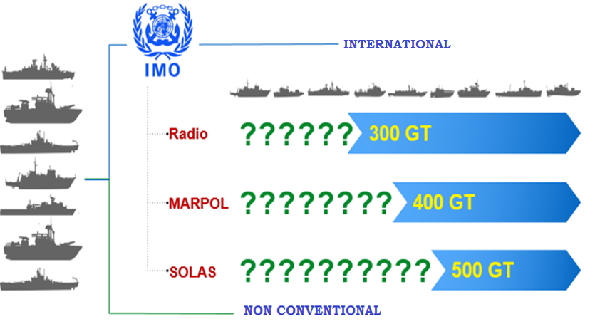
SHIP REGULATIONS

Slide 4
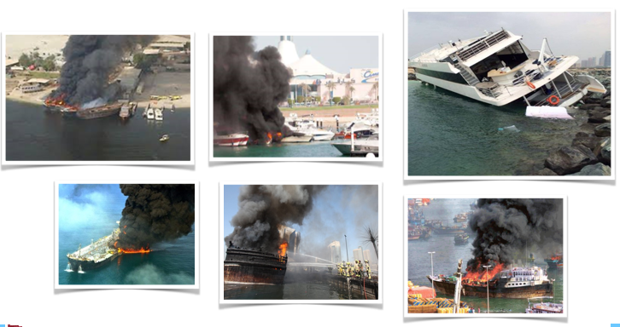
ACCIDENTS DUE TO LACK OF DOMESTIC SHIPS REGULATIONS

Slide 5
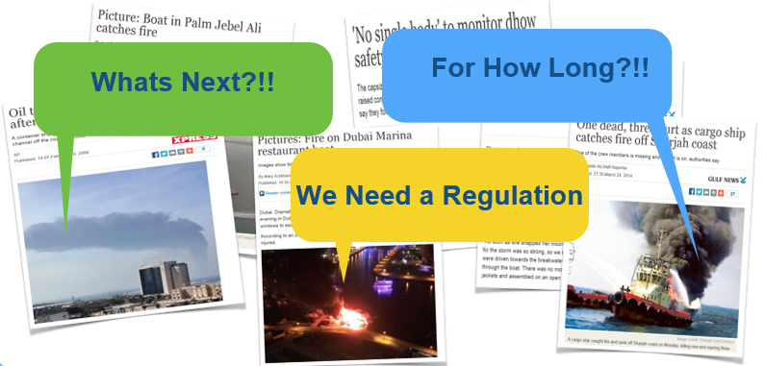
ACCIDENTS DUE TO LACK OF DOMESTIC SHIPS REGULATIONS

Slide 6
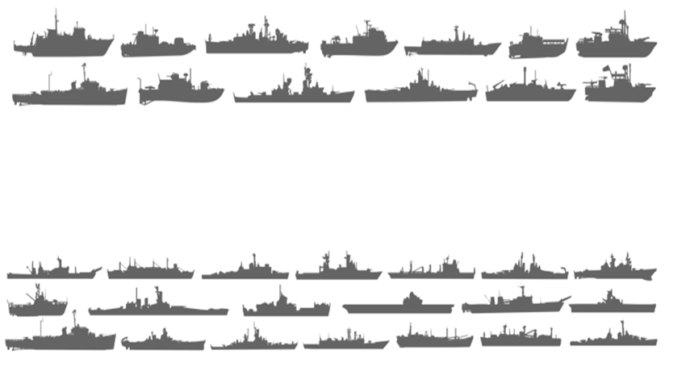
THE GCC CODE PURPOSE
The GCC Code is intended to regulate safety aspects of vessels operating in GCC waters and to protect the crew personnel, maritime environment and asset

Slide 7
THE GCC CODE PURPOSE
Passenger vessels 12m <= L < 24m and carry less than 200 Passengers
All other vessels L > =12 m

Slide 8
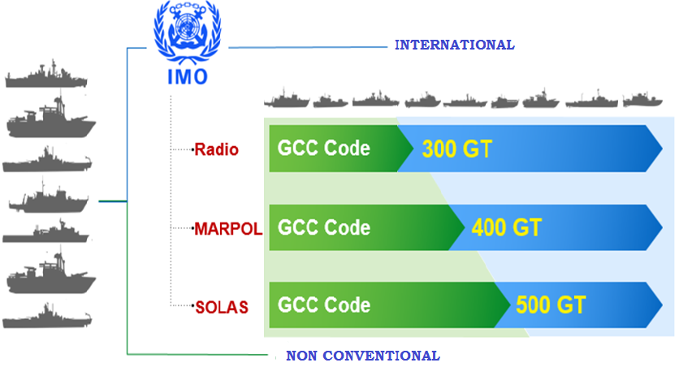
GCC CODE FILLING THE REGULATIONS GAP

Slide 9
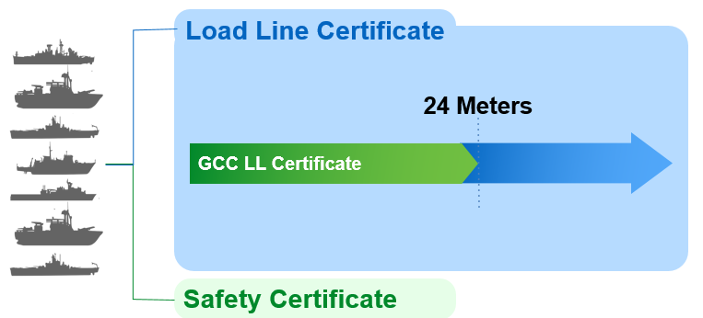
GCC CODE LOAD LINE CERTIFICATE

Slide 10
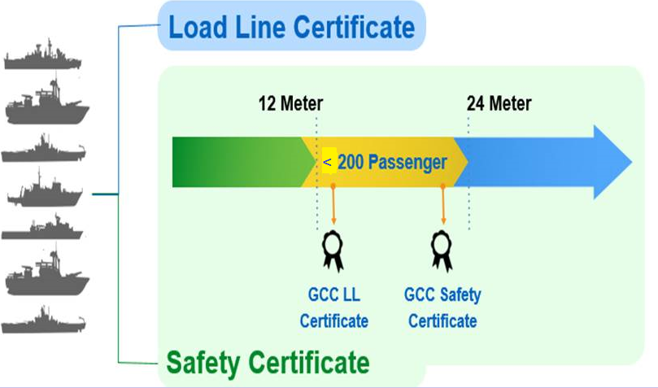
GCC CODE PASSENGER SHIPS CERTIFICATE

Slide 11
DEFINITIONS
A new ship: means a ship the keel of which is laid or which is at a similar stage of construction on or after the date of entry into force of the present Regulations (1st September 2014).
An existing ship: means a ship which is not a new ship.
Length: The length (L) shall be taken as 96 per cent of the total length on a waterline at 85 per cent of the least moulded depth measured from the top of the keel, or as the length from the fore side of the stem to the axis of the rudder stock on that waterline, if that be greater. In ships designed with a rake of keel the waterline on which this length is measured shall be parallel to the designed waterline;

Slide 12
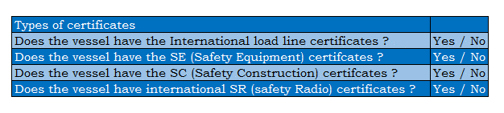
APPLICABILITY
The Safety Regulations will be mandatory for new and existing ships navigating in the GCC Countries Region (except passenger ships) that are not covered by the provisions of the Conventions of the International Maritime Organization (IMO) and load length equal to 12 meter or more.
The GCC load line certificate will be mandatory for all ships which load length overall is less than 24 meter and equal or more than 12 meter.
The GCC code safety certificate, load line certificate and ISM certificate will be mandatory for the passenger ships of which load length equal to 12 meter or more, but less than 24 meter, and carries less than 200 passengers in the territorial waters of the State or making voyages between the countries of the Council.

Slide 13
CONTENTS
Chapter 1 – General Provisions
Chapter 2 – Ships surveys and safety certificates
Chapter 3 – Load Lines
Chapter 4 – Construction / Structure, divisions and equipment
Chapter 5 – Stability and bilge pumping arrangements
Chapter 6 – Machinery installations
Chapter 7 –Electrical installations
Chapter 8 – Fire Protection
Chapter 9 – Life Saving appliances and arrangements
Chapter 10 – Radio Communications
Chapter 11 – Safety of Navigation
Chapter 12 – Safety of Special Ships
Chapter 13 – Prevention of Pollution
Chapter 14 – Safety at work, health, accommodation and prevention of accidents
Chapter 15 – International Safety Management code (ISMC Code)
Chapter 16 – International code for the security of ships and of Port facilities (ISPSC Code)
Chapter 17 – Rules and special instructions on passenger ships
Chapter 18 – Final provision

Slide 14
SURVEY SCOPES
Surveys will be as follows;
Initial
Annual
Annual
Intermediate Survey (including Docking Survey)
Annual Survey
Renewal Survey (including Docking Survey)

Slide 15
CERTIFICATIONS
A certificates for five years will be given to the vessel which is fully complied with GCC Code requirements.
Validity of the Certificates will be for five years subject to annual, Intermediate (Docking Survey) and renewal surveys.
Two main certificates to be given to ship owners as follows:
G.C.C. Load line Certificate: this will be given to small vessels below 24 meter which is not covered by the International Load Line Convention, 1966.
G.C.C. Safety Certificate: this will be given to all vessels below 500 GT which is not covered by the International Convention for the Safety for the Safety of Life at Sea (SOLAS, 1974).SOLAS.
Additional Certifications will be given as case-by-case and based on type survey requirement includes but not limited to:
International Safety Management (ISPS) (Re. 130 & 131):
Compliance with ISM Code:
Compulsory for Passenger vessels
Voluntary for cargo ships
Compliance with ISPS Code:
Voluntary for both passenger and cargo vessels.
b. Issue Certificates (Reg. 25) for GCC MARPOL will be limited for:
existing vessels to annex I, Annex IV; and
new ship all annexes as applicable.

Slide 16
GCC CODE ADDITIONAL CERTIFICATES
Document of Compliance for the carriage of Dangerous Goods Certification: Mandatory for Ships and barges which carry goods subject to the provisions of Chapters VI and VII of the SOLAS Convention, Annexes I, II and III of MARPOL and the related Codes: 1.1 bulk grain; 1.2 dangerous goods in packaged form or in bulk; 1.3 liquid chemicals in bulk; 1.4 liquefied gases in bulk; and 1.5 other goods in bulk.

Slide 17
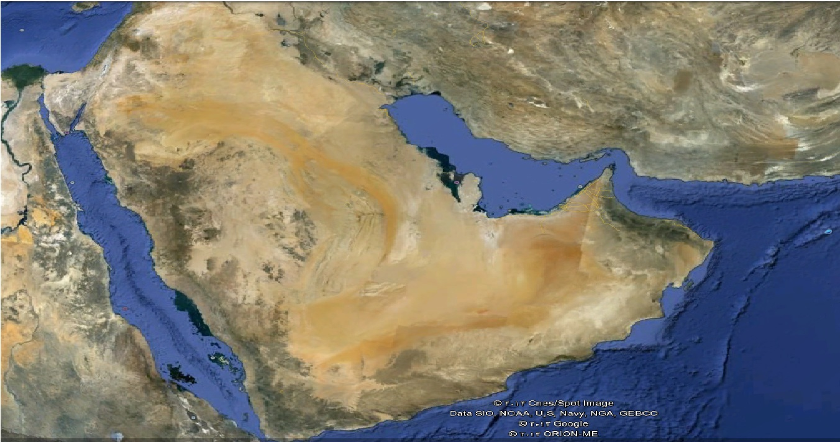
GCC CODE vs INTERNATIONAL CERTIFICATIONS
If ship exclusively operating in UAE (GCC) Waters and have full certification of the GCC Code then the need of International Certifications MAY be waived as long as ship not engaging in international voyages

Slide 18
GCC CERTIFICATES

Slide 19
BENEFITS TO OWNERS
Protect the Asset (ship) &Proper Maintenance
  -Vessel has been surveyed and maintained to appropriate Code standards.
  -A vessel must conduct annual surveys to verify that it is maintained to GCC Code and in conformance with the Requirements of GCC Code.
Exercise Due Diligence
  -GCC Code will be one indication that the ship owner has exercised due diligence during the service life of the vessel.
  -Premium insurance goes down after GCC implementation.
Comply with Statutory Requirements
  The GCC Countries’ have mandated that vessels under convention size entering into their registry be comply with GCC Code.

Slide 20
BENEFITS TO AUTHORITY
The GCC Countries’ have mandated that vessels under convention size entering into their registry be comply with GCC Code.
The implementation will be distributed to all aspects of safeties by means of crew personnel (training, qualification).
Protect the environment (eliminate pollution at sea).
The accidents related to safety in principles goes down dramatically

